Slide 1

Gator Society for Pre-Law Women Second General Body Meeting

Slide 2

Hello!
Thank you for expressing an interest in G.S.P.W.!
We are so excited to welcome you to our sisterhood of diverse young women seeking a potential future in law.

Slide 3
Meet the E-Board
President: Jennifer Rogers-Transfer-Poli Sci Major- Sociology Minor-Loves animals, sleep, & art!
Vice President: Rachel Hujsa-Senior-Double Major in History & Music- Anthro Minor-Loves music, thrifting, & coffee!
Treasurer: Maddie Feit-Junior-PR Major-Innovation Minor-Loves shopping, movies, & Halloween parties!
Secretary: Jacqueline Hahn-Junior-Double Major in Poli Sci & English- Loves reading, finding new music, & toast!
Vice President of External Affairs: Daniela Ordoñez-Junior-Poli Sci Major- Sociology Minor- Loves thrifting, making Spotify playlists, & trying new foods!
Legal Coordinator Chair: Priyanka Pandya-Junior Pre-Prof. Bio Major- Sociology Minor-Loves cooking, traveling, & dancing!

Slide 4
About G.S.P.W.
A sisterhood of diverse, accepting, and ambitious women exploring the possibility of a future career in law. This club will assist aspiring female lawyers through guest speakers, LSAT prep workshops, and bimonthly charitable fundraisers

Slide 5

Membership Requirements & How To Join
Fill out a Google interest form
Formal applications for new members will be posted to the website after October 1st
Attend our biweekly GBMs
Follow us on social media to stay in the know!
Can’t make a meeting? No sweat you can find all the info on our social media and website once it’s finalized.
http://gsplwomen.com/

Slide 6

Club Dues
Fall 2020
Considering that every club activity will be held virtually there will be no dues necessary this semester!
Spring 2021
Hopefully with the New Year we will be able to host in person events (safely and in accordance to CDC and university guidelines). Club dues will be $25, your dues will go towards G.S.P.W. t-shirts, stickers, and masks!

Slide 7
Guest Speakers
Ideally guest speaker meetings will occur 2 to 4 times per semester. Guest speakers will be chosen based off current and previous legal related positions throughout the state or country. Each speaker will be asked to give a brief presentation about their journey into law and any advice/tips that they may feel inclined to share with us. We will then open the floor to a Q and A portion of the meeting where we may ask the speakers questions (either on live Zoom calls or open forums on social media platforms) pertaining to problem specific circumstances of women in the legal profession and how best to prepare for our future endeavors.

Slide 8
Bimonthly Fundraisers
Among all that this year has thrown at us, Gator Society for Pre-Law Women will strive to give back to the community through bimonthly fundraisers, we will collectively choose a charity on the local, state, national, or global level and donate whatever money is acquired to the chosen cause.
We will vote for each fundraiser and all proceeds will be donated to the specified charity.
Once we decide on the cause (decision verified by next meeting, 10/14), we have 2 months from that date to market and raise revenue for it (all proceeds due by 12/2)! We will post to social media our fundraising templates so you can copy and share.

Slide 9
Fundrasing Ballot
If you are passionate about a certain cause, PLEASE write it in the GroupMe and include a link to the website so it can be added to the ballot!
VocaliD- VocaliD has been at the forefront of creating custom synthetic voices using state-of-the-art machine learning and speech blending algorithms since 2014. A voice AI company with deep scientific roots, VocaliD holds innovative patents in distributed voice collection and synthetic voice aging. (https://vocalid.ai/)
Peaceful Paths- Peaceful Paths is the certified domestic violence center that serves survivors of domestic violence in Alachua, Bradford, and Union counties. Peaceful Paths provides a wide range of services including emergency shelter, 24-hour helpline, victim advocacy, children’s programming, education and training, crisis counseling and support groups, community awareness and intervention, and violence prevention programs. (https://www.peacefulpaths.org/aboutus)

Slide 10

LSAT PREP
LSAT prep workshops will be sporadic and optional yet highly encouraged, we would have sectional break downs in which we focus on one of the many components of the test or examine previously issued tests with effort further our comprehension of the LSAT and to improve our test scores overall.
Like our Facebook page: Gator Society for Pre-Law Women
Follow us on Instagram: @gator.prelawwomen

Slide 11
Coffee Talks & Related Events
Coffee Talks
Grab your favorite drink and let’s chat! We want to hear your goals and the steps you are taking to achieve them.
Peer Advising
Open to everyone at any year level, Juniors and Seniors will assist Freshman and Sophomores with scheduled LSAT study tips, course recommendations, and general support!
Team Bonding
We will host Zoom conferences and eventually in person arts and craft extravaganzas and seasonal cooking/baking bonanzas! We will primarily utilize Instagram and Facebook Live.
It should be noted that these events are OPTIONAL and will occur SPORADICALLY

Slide 12

People ask me, “If you could be whatever you wanted to be, what would you be?” My first answer is not “ a great lawyer.” It is, “I would be a great diva.” But I totally lacked that talent, so the next best thing is the law.
- Justice Ruth Bader Ginsburg
Yes, I reused last weeks’ quote because RBG sadly passed on 9/18/2020. R.I.P. to an icon ☹

Slide 13


Want to Join the Dream Team?
Board of Executives
Vice President of Internal Affairs
Leadership Board
Communications and Multimedia Director
Librarians (x2)
Historians (x2)
Membership Director Chair
Executive Membership Director
How to Apply!
We are currently seeking ambitious and committed young women to join our Board of Executives and Leadership Board. Becoming a part of E-Board will open the door for cultivating hands-on leadership skills!
Contact a current Executive or email a resume and interest letter t0- networking.gspw@gmail.com

Slide 14
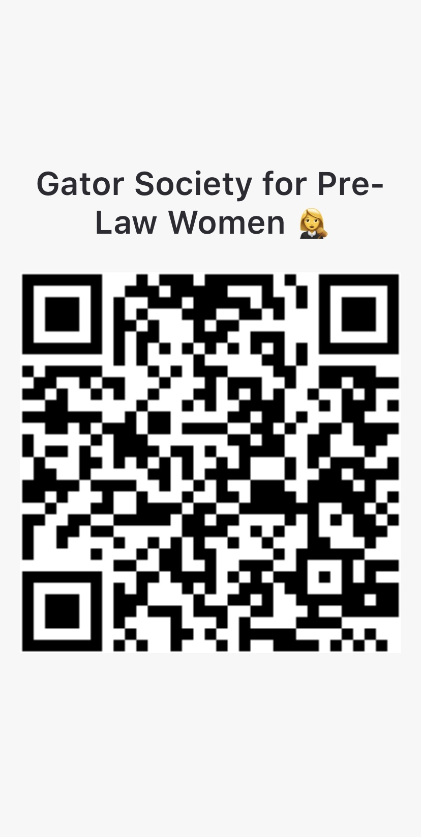
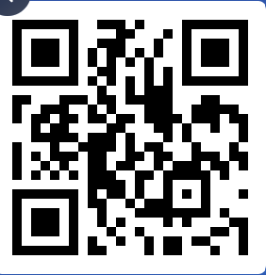
Thanks for attending!
GroupMe!
Any questions?
Website: http://gsplwomen.com/
Like our Facebook page: Gator Society for Pre-Law Women
Follow us on Instagram: @gator.prelawwomen
Text @gspw2020 to 81010 to join our Remind
Scan the left QR Code to join our GroupMe
Scan the right QR Code to answer a Slido Poll
Slido Poll

