Slide 1

Gator Society for Pre-Law Women First General Body Meeting

Slide 2

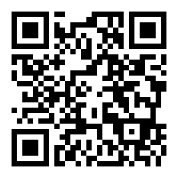
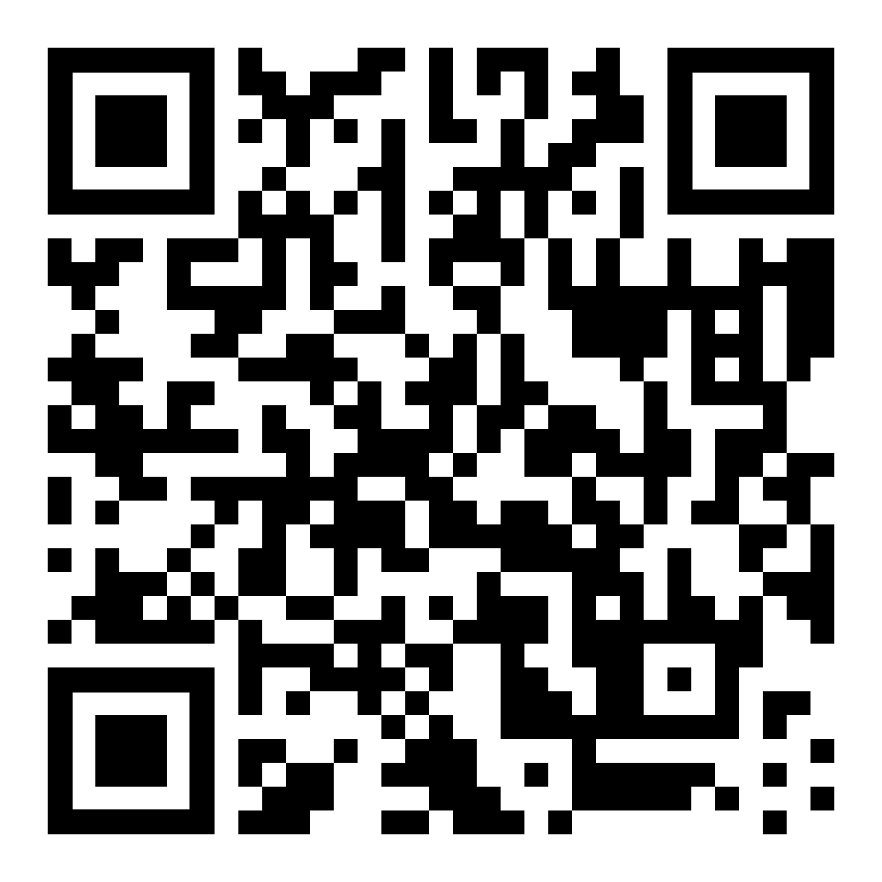
Florida Voter Registration Deadline: October 5th
bit.ly/uflvote
bit.ly/flpledges
Register to vote or update your current address:
Pledge to vote safely and receive reminders about the election:

Slide 3

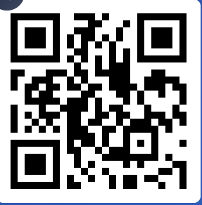

Hello!
We are so excited to welcome you to our new club!
The following slides will discuss what you can expect from us, how you can get involved, and the benefits of joining our organization.

Slide 4

Your E-Board Thus far..
President
Vice President
Treasurer
Legal Coordinator Chair
Jennifer Rogers
Transfer
Poli Sci Major- Sociology Minor
Loves animals, sleep, and art!
Rachel Hujsa
Senior
Double Major in History & Music- Anthro Minor
Loves music, thrifting, and coffee!
Maddie Feit
Junior
PR Major-Innovation Minor
Loves shopping, movies, and Halloween parties!
Priyanka Pandya
Junior
Pre-Prof. Bio Major- Sociology Minor
Loves cooking, traveling, and dancing!

Slide 5


About us
A sisterhood of diverse, accepting, and ambitious women exploring the possibility of a future career in law. This club will assist aspiring female lawyers through guest speakers, LSAT prep workshops, and bimonthly charitable fundraisers.
Be on the lookout for a Facebook poll on our club page, we want to know what times work best for you! Can’t make a meeting? No sweat you can find all the info on our social media and website once it’s finalized.
http://gsplwomen.com/

Slide 6

Steps to join:
Fill out a Google interest form
Formal applications for new members will be posted to the website after October 1st
Attend our biweekly GBMs
Follow us on social media to stay in the know!

Slide 7

Club Values
This club will not only teach pre-law women the etiquette, professional attire, and grit to be a lawyer, but it will also teach us to be compassionate and loving to ourselves and those around us. G.S.P.W is an excellent opportunity for young women eager to enter the field of law. Although this first semester will be strictly virtual, we will not expect any of our members to be incredibly tech savvy in order to enjoy our club, thus just by simply following the social media pages or watching/viewing meetings found on the website, new applicants can join easily. Through speaking with accomplished lawyers and helping one another prepare for the intense career we desire; we shall gain invaluable knowledge and experience. This club celebrates inclusivity and will equip pre-law women with the means necessary to start off on the right foot in their budding law careers.

Slide 8

Continuation of Club Values
Gator Society for Pre-Law Women will work to harness each members’ strong legal attributes and help hone the skills necessary to enter such a vigorous career. This club will celebrate multiracial, multicultural, and multi-ethnic women and allow them to freely express their beliefs and desires as a pre-law student in a comforting and accepting space. G.S.P.W. will be founded with love. Love for women, love for legal studies, love for humanity, and love for preparedness. Love will allow the club to create a solid and mutual foundation of understanding and appreciation for one another and everyone’s individualized goals. Essentially G.S.P.W would aim to be a sisterhood without the fees associated with a sorority. Lastly, G.S.P.W. will help to diversify a predominantly male dominated career and not only open the door for more women to flourish in the legal field but specifically allow more women of color to do so as well. Through the contacts and information, each member will have an equal opportunity for success, support, and preparation.

Slide 9

Club Dues
Fall 2020
Considering that every club activity will be held virtually there will be no dues necessary this semester!
Spring 2021
Hopefully with the New Year we will be able to host in person events (safley and in accordance to CDC and university guidelines). Club dues will be $25, your dues will go towards G.S.P.W. t-shirts, stickers, and masks!

Slide 10

Guest Speakers
Ideally guest speaker meetings will occur 2 to 4 times per semester. Guest speakers will be chosen based off current and previous legal related positions throughout the state or country. Each speaker will be asked to give a brief presentation about their journey into law and any advice/tips that they may feel inclined to share with us. We will then open the floor to a Q and A portion of the meeting where we may ask the speakers questions (either on live Zoom calls or open forums on social media platforms) pertaining to problem specific circumstances of women in the legal profession and how best to prepare for our future endeavors.

Slide 11

LSAT Prep
LSAT prep workshops will be sporadic and optional yet highly encouraged, we would have sectional break downs in which we focus on one of the many components of the test or examine previously issued tests with effort further our comprehension of the LSAT and to improve our test scores overall.
We implore you to respond to our social media posts in the comments section and provide your reasoning, turn the comments section into a discussion! Feel free to share tips/tricks/hacks and out-of-the-box thinking!
Like our Facebook page: Gator Society for Pre-Law Women
Follow us on Instagram: @gator.prelawwomen
Bring the attention of your audience over a key concept using icons or illustrations

Slide 12

Bimonthly Fundraisers
Among all that this year has thrown at us, Gator Society for Pre-Law Women will strive to give back to the community through bimonthly fundraisers, we will collectively choose a charity on the local, state, national, or global level and donate whatever money is acquired to the chosen cause.
We will vote for each fundraiser and all proceeds will be donated to the specified charity.

Slide 13

Coffee Talks & Related Events
Coffee Talks
Grab your favorite drink and let’s chat! We want to hear your goals and the steps you are taking to achieve them.
Peer Advising
Open to everyone at any year level, Juniors and Seniors will assist Freshman and Sophmores with scheduled LSAT study tips, course reccomendations, and general support!
Team Bonding
We will host Zoom conferences and eventually in person arts and craft extravaganzas and seasonal cooking/baking bonanzas! Let’s pause on chasing the bag and chill for an evening.
.
**It should be noted that these events are OPTIONAL and will occur SPORADICALLY**

Slide 14
People ask me, “If you could be whatever you wanted to be, what would you be?” My first answer is not “ a great lawyer.” It is, “I would be a great diva.” But I totally lacked that talent, so the next best thing is the law.
- Justice Ruth Bader Ginsburg

Slide 15
We are currently seeking ambitious and committed young women to join our Board of Executives and Leadership Board. Becoming a part of E-Board will open the door for hands-on leadership building skills!
Want to Join the Dream Team?
Contact a current Executive or email a resume and interest letter to networking.gspw@gmail.com

Slide 16

Vacant Positions
Secretary
Vice President of Internal Affairs
Vice President of External Affairs
Communications and Multimedia Director
Librarians (x2)
Historians (x2)
Membership Director Chair
Executive Membership Director
Board of Executives
Leadership Board

Slide 17
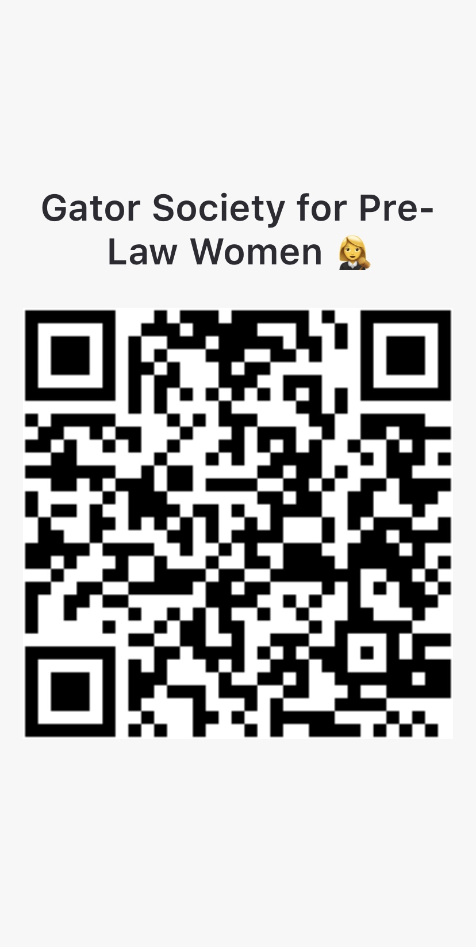
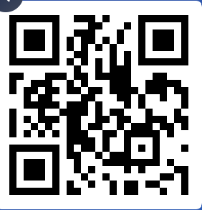
Thanks for attending!
GroupMe!!
Slido Poll!!
Any questions?
Website: http://gsplwomen.com/
Like our Facebook page: Gator Society for Pre-Law Women
Follow us on Instagram: @gator.prelawwomen
Text @gspw2020 to 81010 to join our Remind
Scan the left QR Code to join our GroupMe
Scan the right QR Code to answer a Slido Poll

